Slide 1
Classification by Decision Tree Induction
Prof. Dr. Songül Varlı
Yıldız Technical University
Department of Computer Engineering
svarli@yildiz.edu.tr

Slide 2
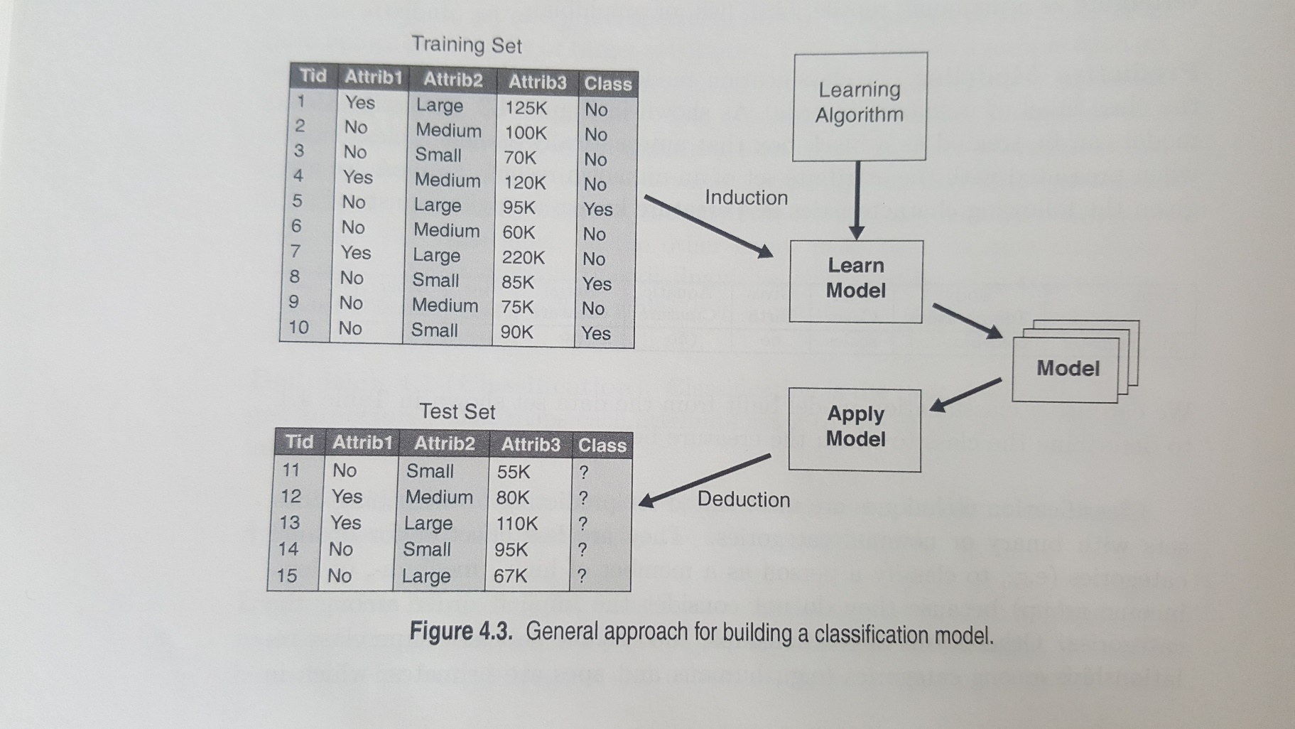
General Approach for Building a Classification Model

Slide 3
Decision Trees
Decision Tree induction is the learning of decision trees from class-labeled training tuples(instances).
A decision tree is a flowchart-like tree structure, where each internal node (nonleaf node) denotes a test on attribute, each branch represents an outcome of the test, and leaf node (or terminal) holds a class label.
The topmost node in a tree is the root node

Slide 4
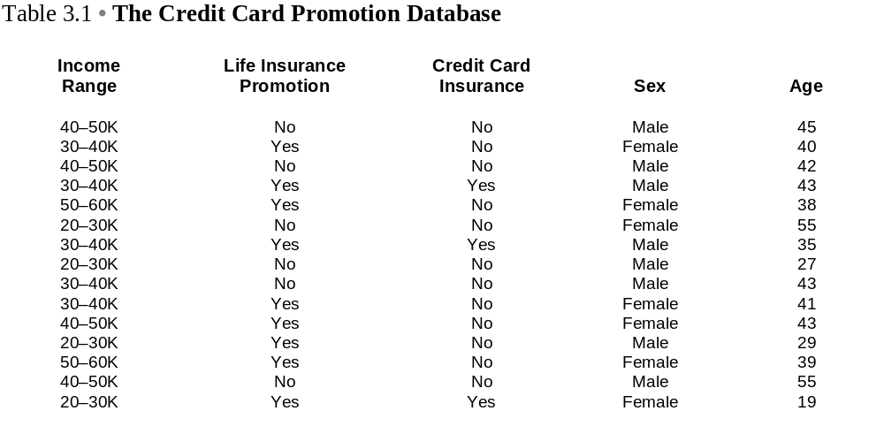
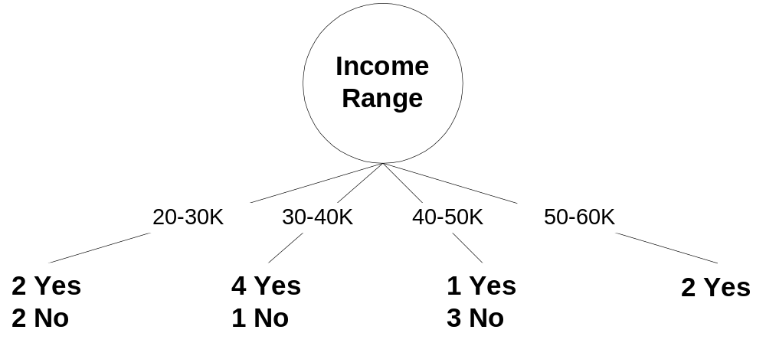
Decision Trees
Output Variable
A partial decision tree with root node=income range

Slide 5
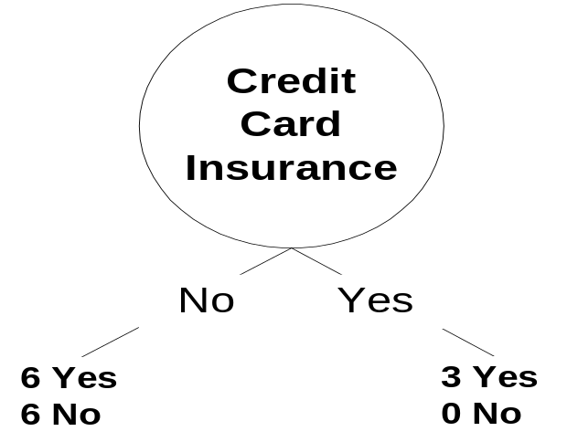
Decision Tree
A partial decision tree with
root node=CreditCardInsurance

Slide 6
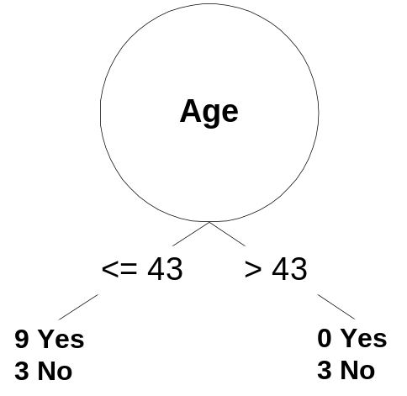
Decision Tree
A partial decision tree with root node=age

Slide 7
Decision Tree Induction
During late 1970’s, Ross Quinlan, a researcher in Machine Learning, developed a decision tree algorithm as ID3 (Iterative Dichotomiser).
This work is expanded and presented C4.5, which became a benchmark to which newer supervised learning algorithms are often compared.

Slide 8
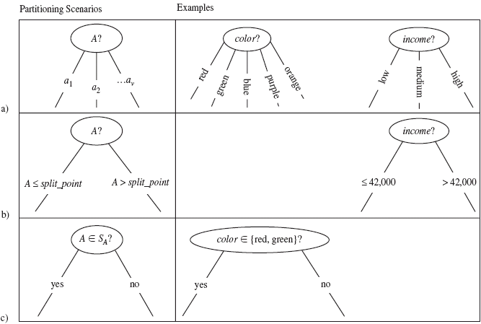
Three possibilities for partitioning tubles based on the splitting criterion, shown with examples;
a- If A is discrete-valued
b- If A is continuous-value, then two branchs are grown
c- If A is discrete-valued and binary tree must be produced

Slide 9
An Algorithm for Building
Decision Trees
Let T be the set of training instances.
Choose an attribute that best differentiates the instances in T.
Create a tree node whose value is the chosen attribute.
  Create child links from this node where each link represents a unique value for the chosen attribute.
  Use the child link values to further subdivide the instances into subclasses.
For each subclass created in step 3:
  If the instances in the subclass satisfy predefined criteria or if the set of remaining attribute choices for this path is null, specify the classification for new instances following this decision path.
  If the subclass does not satisfy the criteria and there is at least one attribute to further subdivide the path of the tree, let T be the current set of subclass instances and return to step 2.

Slide 10
Information Gain -Entropy
In order to define information gain precisely, we use a measure commonly used in information theory, called entropy
Entropy characterizes the (im)purity of an arbitrary collection of examples.

Slide 11
Entropy
Given a collection S, containing positive and negative examples of some target concept, the entropy of S relative to this binary classification is:
Entropy(S) = -(p₊ log₂p₊ + p₋ log₂p₋ )
  S is a sample of training examples
  p+ is the proportion of positive examples
  p- is the proportion of negative examples
entropy is a measure of the impurity in a collection of training examples

Slide 12
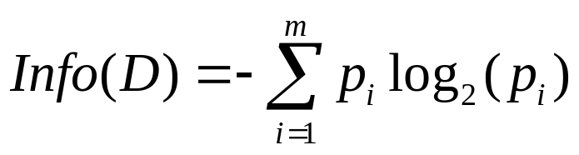
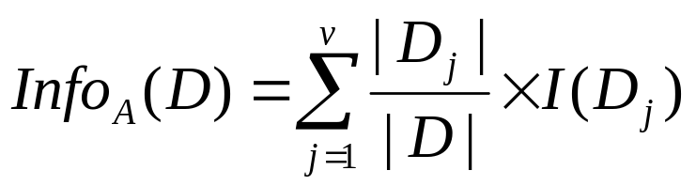
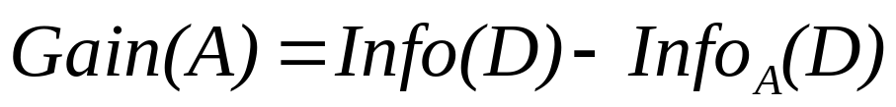
Attribute Selection Measure: Information Gain (ID3/C4.5)
Select the attribute with the highest information gain
Let p_{i} be the probability that an arbitrary tuple in D belongs to class C_{i}, estimated by |C_{i, D}|/|D|
Expected information (entropy) needed to classify a tuple in D:
Information needed (after using A to split D into v partitions) to classify D:
Information gained by branching on attribute A

Slide 13






Attribute Selection: Information Gain
Class P: buys_computer = “yes”
Class N: buys_computer = “no”
means “age <=30” has 5 out of 14 samples, with 2 yes’es and 3 no’s. Hence
Similarly,

Slide 14
Decison Tree:
Weekend example
1.step: Let T be the set of training instances.
Weekend (Example) | Weather | Parents | Money | Decision (Category
W1 | Sunny | Yes | Rich | Cinema
W2 | Sunny | No | Rich | Tennis
W3 | Windy | Yes | Rich | Cinema
W4 | Rainy | Yes | Poor | Cinema
W5 | Rainy | No | Rich | Stay in
W6 | Rainy | Yes | Poor | Cinema
W7 | Windy | No | Poor | Cinema
W8 | Windy | No | Rich | Shopping
W9 | Windy | Yes | Rich | Cinema
W10 | Sunny | No | Rich | Tennis

Slide 15
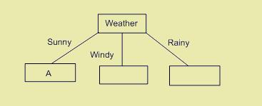
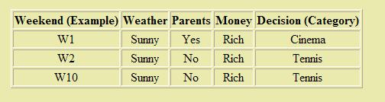
Decison Tree:
Weekend example
2. Step:Choose an attribute that best differentiates the instances in T.
3. Step: Create a tree node whose value is the chosen attribute.

Slide 16
Decison Tree: Entropy
For the 10 Training instances
  6 : Go to Cinema
  2 : Play Tennis
  1 : Stay at Home
  1 : Go to Shopping
Entropy:
H(T)= - (6/10) log₂(6/10) - (2/10) log₂(2/10) - (1/10) log₂(1/10) - (1/10) log₂(1/10)
H(T)= 1.571

Slide 17
Decision Tree:
Information Gain
Gain(T, weather)= ?
  Sunny=3 (1 Cinema, 2 Tennis)
  Windy=4 (3 Cinema, 1 Shopping)
  Rainy=3 (2 Cinema, 1 Stay in)
  Entropy(T_{sunny})= - (1/3) log₂ (1/3) - (2/3) log₂ (2/3)=0,918
  Entropy(T_{windy})= - (3/4) log₂ (3/4) - (1/4) log₂ (1/4) =0,811
  Entropy(T_{rainy})= - (2/3) log₂ (2/3) - (1/3) log₂ (1/3) =0,918
Gain(T, weather) = Entropy(T)- ((P(sunny)Entropy(T_{sunny}) +
P(windy) Entropy(T_{windy})+ P(rainy) Entropy(T_{rainy}) )
=1.571- ((3/10)Entropy(T_{sunny})+(4/10)Entropy(T_{windy})+ (3/10)Entropy(T_{rainy}))
Gain(T, weather) =0.70

Slide 18
Decision Tree:
Information Gain
Gain(T, parents)= ?
  Yes=5 (5 Cinema)
  No =5 (2 Tennis, 1 Cinema, 1 Shopping, 1 Stay in)
  Entropy(T_{yes})= - (5/5) log₂ (5/5) = 0
  Entropy(T_{no})= - (2/5) log₂ (2/5) - 3(1/5) log₂ (1/5) =1.922
Gain(T, parents) = Entropy(T)- ((P(yes)Entropy(T_{yes}) +
P(no) Entropy(T_{no}))
=1.571- ((5/10)Entropy(T_{yes})+(5/10)Entropy(T_{no}))
Gain(T, parents)=0.61

Slide 19
Decision Tree:
Information Gain
Gain(T, money)= ?
  Rich=7 (3 Cinema, 2 Tennis, 1 Shopping, 1 Stay in)
  Poor=3 (3 Cinema)
  Entropy(T_{rich})= 1.842
  Entropy(T_{poor})= 0
Gain(T, money) = Entropy(T)- ((P(rich)Entropy(T_{rich}) +
P(poor) Entropy(T_{poor}))
=1.571- ((5/10)Entropy(T_{rich})+(5/10)Entropy(T_{poor}))
Gain(T, money)=0.2816

Slide 20
Decision Tree:
Information Gain
Gain(T, weather) =0.70
Gain(T, parents)=0.61
Gain(T, money)=0.2816
Create a tree node whose value is the chosen attribute.

Slide 21
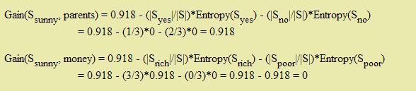
Decision Trees:
  Create child links from this node where each link represents a unique value for the chosen attribute.
  Use the child link values to further subdivide the instances into subclasses.

Slide 22
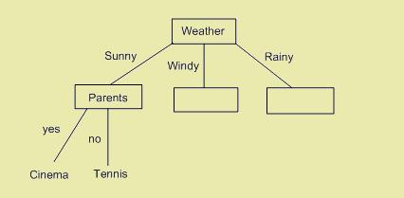
Decision Trees:
  If the instances in the subclass satisfy predefined criteria or if the set of remaining attribute choices for this path is null, specify the classification for new instances following this decision path.
  If the subclass does not satisfy the criteria and there is at least one attribute to further subdivide the path of the tree, let T be the current set of subclass instances and return to step 2.

Slide 23
Example for Numeric Attribute
A1 | A2 | A3 | Class
A | 70 | True | CLASS1
A | 90 | True | CLASS2
A | 85 | False | CLASS2
A | 95 | False | CLASS2
A | 70 | False | CLASS1
B | 90 | True | CLASS1
B | 78 | False | CLASS1
B | 65 | True | CLASS1
B | 75 | False | CLASS1
C | 80 | True | CLASS2
C | 70 | True | CLASS2
C | 80 | False | CLASS1
C | 80 | False | CLASS1
C | 96 | False | CLASS1
  Nine samples belongs to CLASS1 and five samples to CLASS2, so entropy before splitting is
  Info(T)=0.940 bits
  Gain(A1)=0.940-0.694=0.246 bits
  Gain(A3)=0.940-0.892=0.048 bits

Slide 24
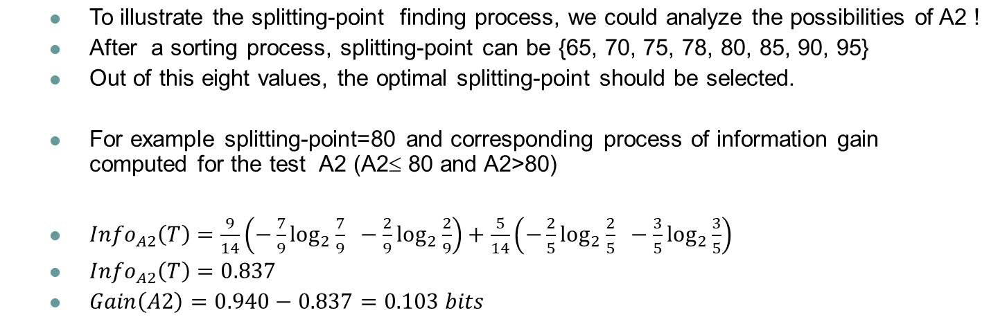
Example for Numeric Attribute
Ordered Numerical attribute
Age | 65 | 70 | 70 | 70 | 75 | 78 | 80 | 80 | 80 | 85 | 90 | 90 | 95 | 96
Class Label | C1 | C1 | C1 | C2 | C1 | C1 | C2 | C1 | C1 | C2 | C2 | C1 | C2 | C1

